Slide 1

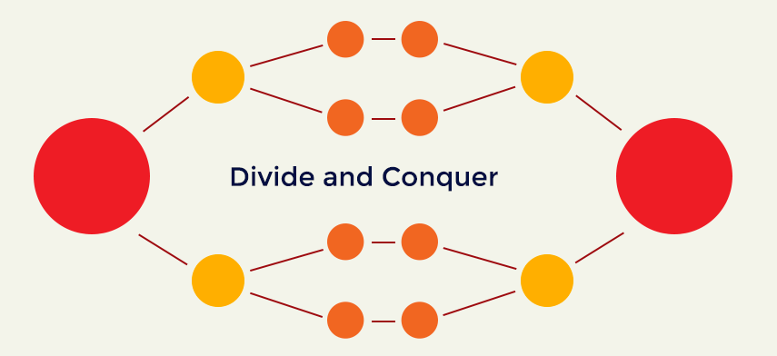

Slide 2
DIVIDE AND CONQUER
Divide the problem into sub-problems that are similar to the original but smaller in size.
Conquer the sub-problems by solving them recursively. If they are small enough, just solve them in a straightforward manner.
Combine the solutions to create a solution to the original problem

Slide 3
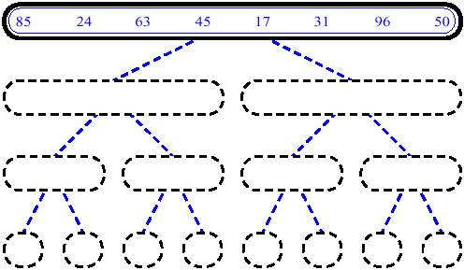
MERGESORT

Slide 4
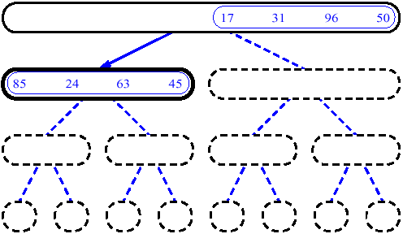
CONT…

Slide 5
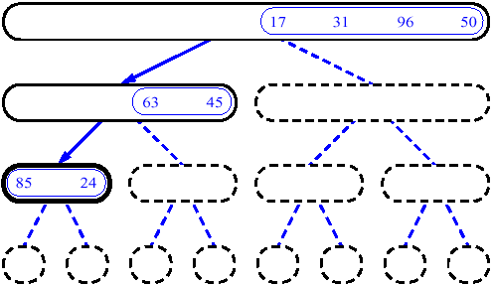
CONT…

Slide 6
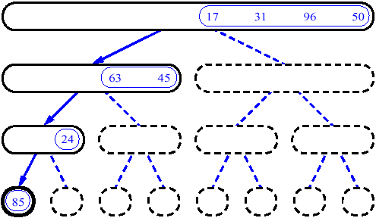
CONT…

Slide 7
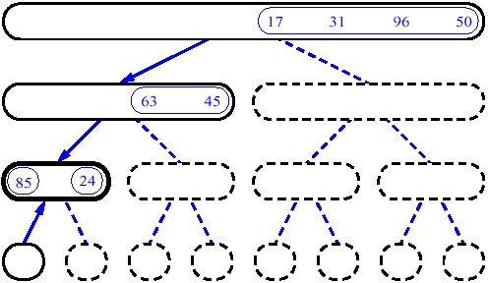
CONT…

Slide 8
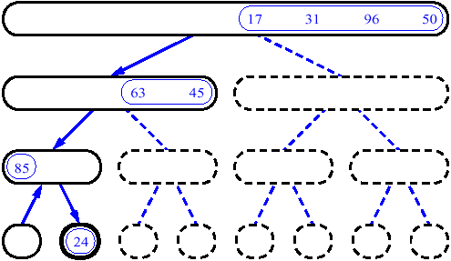
CONT…

Slide 9
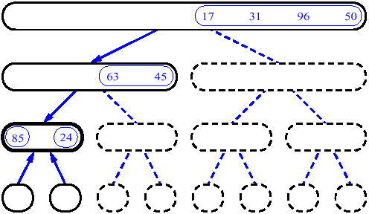
CONT…

Slide 10
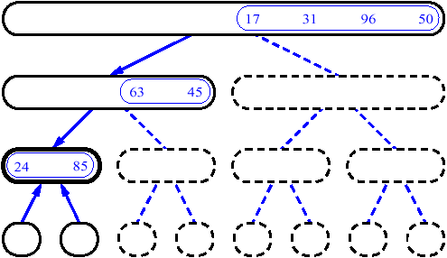
CONT…

Slide 11
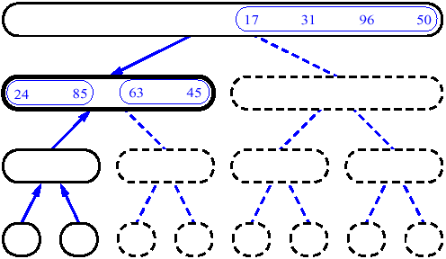
CONT…

Slide 12
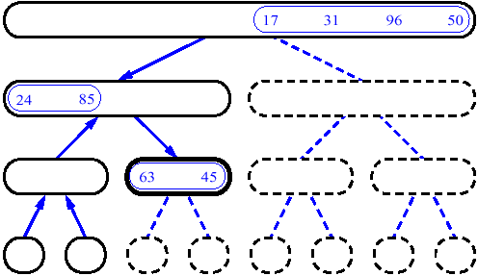
CONT…

Slide 13
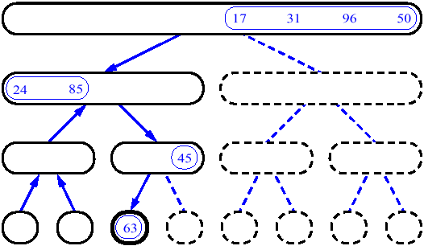
CONT…

Slide 14
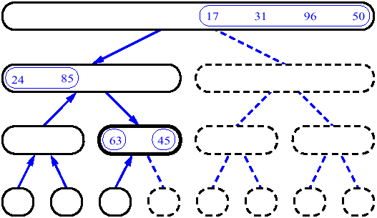
CONT…

Slide 15
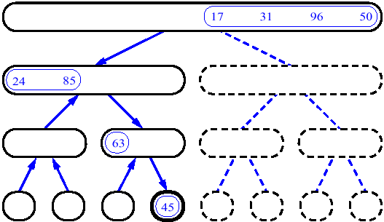
CONT…

Slide 16
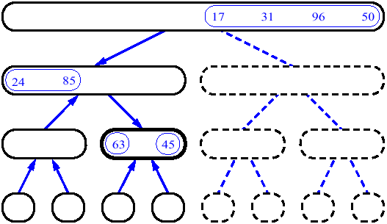
CONT…

Slide 17
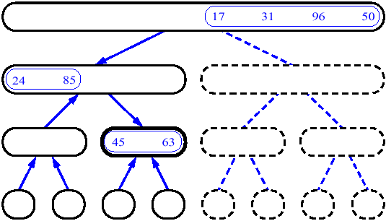
CONT…

Slide 18
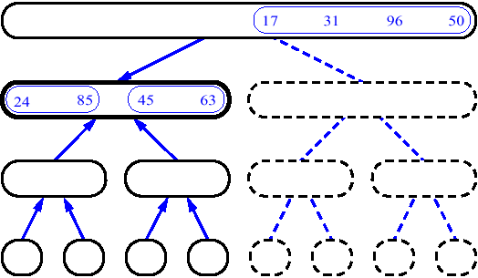
CONT…

Slide 19
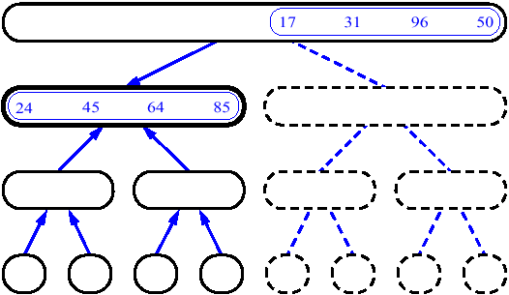
CONT…

Slide 20
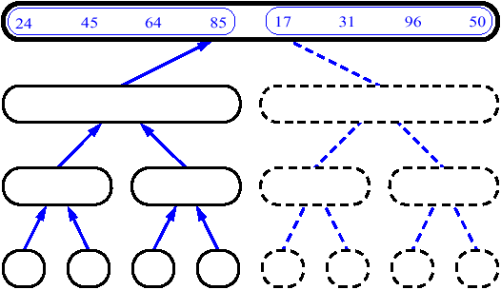
CONT…

Slide 21
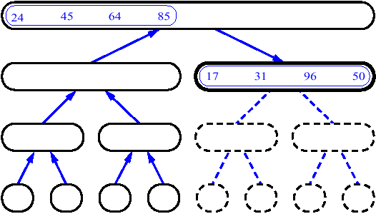
CONT…

Slide 22
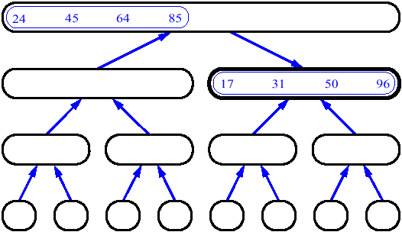
CONT…

Slide 23
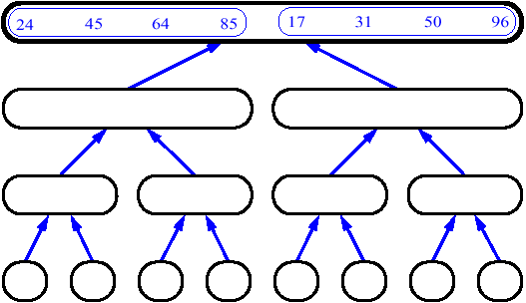
CONT…

Slide 24
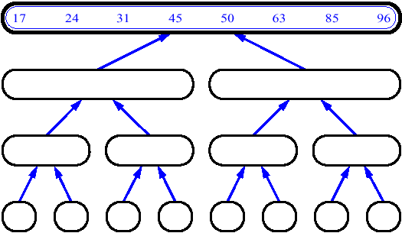
CONT…

Slide 25
14
23
45
98
6
33
42
67

Slide 26
14
23
45
98
6
33
42
67
Merge

Slide 27
14
23
45
98
6
33
42
67
6
Merge

Slide 28
14
23
45
98
6
33
42
67
6
14
Merge

Slide 29
14
23
45
98
6
33
42
67
6
14
23
Merge

Slide 30
14
23
45
98
6
33
42
67
6
14
23
33
Merge

Slide 31
14
23
45
98
6
33
42
67
6
14
23
33
42
Merge

Slide 32
14
23
45
98
6
33
42
67
6
14
23
33
42
45
Merge

Slide 33
14
23
45
98
6
33
42
67
6
14
23
33
42
45
67
Merge

Slide 34
14
23
45
98
6
33
42
67
6
14
23
33
42
45
67
98
Merge

Slide 35
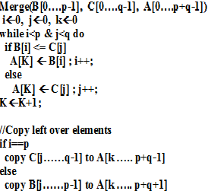
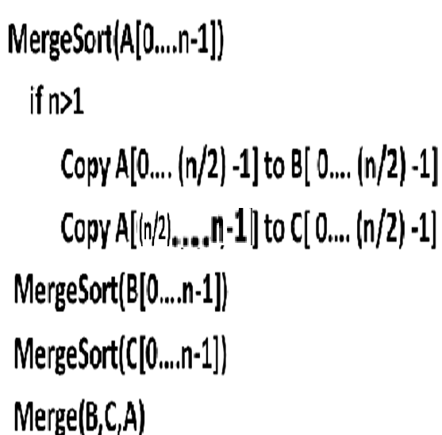
ALGORITHM

Slide 36
8
3
2
9
7
1
5
4

Slide 37
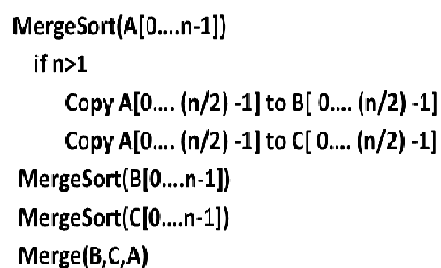
T(n)
T(n/2)
T(n/2)
T(n)
T(n)= 2T(n/2) +cn

Slide 38
APPROACHES TO SOLVE RECURSION
Approach 1:
Intuitive solution to recurrence is to “unroll” the recursion, accounting for the running time of first few levels.
Identify a pattern that can be continued as the recursion expands.
Sum the running times over all levels of the recursion and thereby arrives at a total running time.

Slide 39
Step1: Analyze the first few levels.
1st level of recursion → Single problem of size n → O(n)
2nd level of recursion → 2 problems each of size n/2 → O(n/2)
3rd level of recursion → 4 problems each of size n/4 → O(n/4)
Step 2: Identifying the pattern.
At level j of the recursion, the number of subproblems are now a total of 2^{j}
Each problem has shrunk in size by factor of 2 “j” time → n/ 2^{j}
Step 3: Summing overall levels of recursion.
The number of times the input must be halved to reduce the size of n to 1 is log n
There are totally “n” levels of recursion → O( n logn)

Slide 40
ANALYSIS

Slide 41
T(n)
n
T(n/2)
T(n/2)
2(n/2)
T(n/4)
T(n/4)
T(n/4)
T(n/4)
4(n/4)
log₂n
. . .
T(n / 2^{k})
2^{k} (n / 2^{k})
. . .
T(2)
T(2)
T(2)
T(2)
T(2)
T(2)
T(2)
T(2)
n/2 (2)
n log₂n

Slide 42
SUBSTITUTING A SOLUTION INTO THE MERGESORT RECURSION
T(n) = O(n log n)
T(n) = c. n log n
T(n/2) = c. n/2 log n/2
T(n) = 2T (n/2)+ O(n)
T(n) = 2T (n/2)+ cn
T(n)= 2. c. n/2 log n/2 + cn
T(n) = cn. [logn - 1] + cn
T(n) = cn.logn – cn +cn
T(n) = cn.logn
T(n) =O(nlogn)

Slide 43
Analysis
Basic operation - key comparison.
Best Case, Worst Case, Average Case exists?
Execution does not depend on the order of the data
Best case and average case runtime are the same as worst case runtime.
Worst case:
During key comparison, neither of the two arrays becomes empty before the other one contains just one element

Slide 44
Analysis – Worst Case
Assuming for simplicity that total number of elements n is a power of 2, the recurrence relation for the number of key comparisons C(n) is
C_{merge}(n) - the number of key comparisons performed during the merging stage.
At each step, exactly one comparison is made, total comparisons are (n-1)

Slide 45
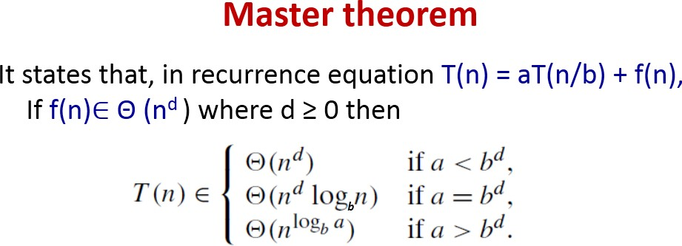
Analysis
Here a = 2, b = 2, f (n) = n-1 = Θ (n) => d = 1.
Therefore 2 = 2¹, case 2 holds in the master theorem
C_{worst} (n) = Θ (n^{d} log n) = Θ (n¹ log n) = Θ (n log n)
Therefore C_{worst}(n) = Θ (n log n)

Slide 46

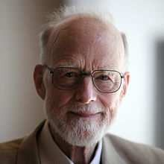
Quick Sort
It is a Divide and Conquer method
Sorting happens in Divide stage itself.
C.A.R. Hoare ( also known as Tony Hore), prominent British computer scientist invented quicksort.

Slide 47
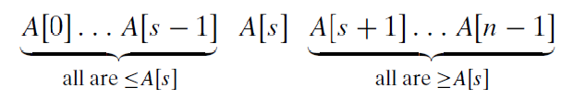
Quick Sort
Quicksort divides (or partitions) array according to the value of some pivot element A[s]
Divide-and-Conquer:
If n=1 terminate (every one-element list is already sorted)
If n>1, partition elements into two; based on pivot element

Slide 48
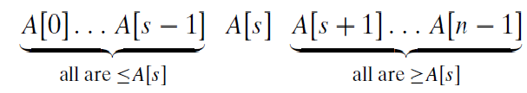
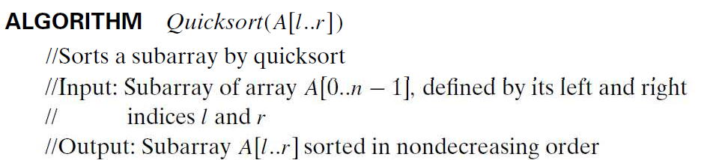
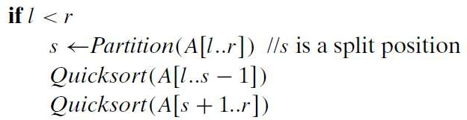
Quick Sort

Slide 49
How do we partition?
There are several different strategies for selecting a pivot and partitioning.
We use the sophisticated method suggested by C.A.R. Hoare, the inventor of quicksort.
Select the subarray’s first element: p = A[l].
Now scan the subarray from both ends, comparing the subarray’s elements to the pivot.

Slide 50
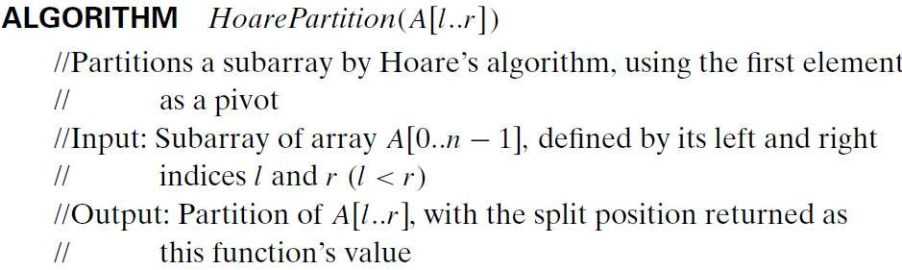

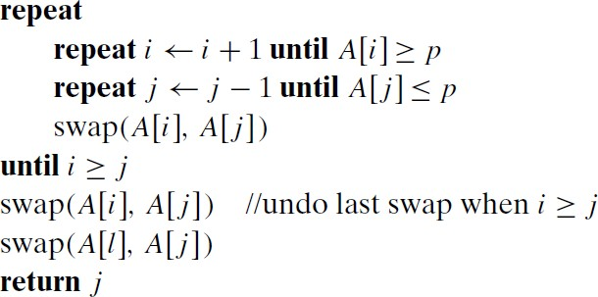
How do we partition?

Slide 51
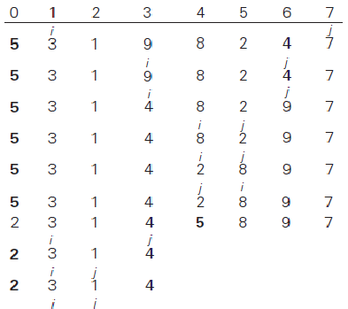

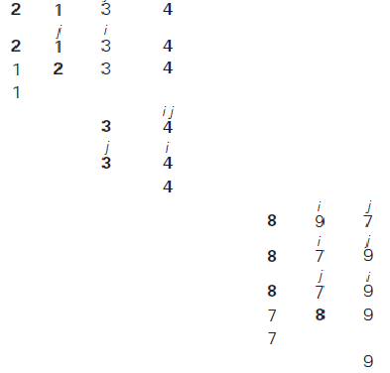











Slide 52
Analysis
Basic Operation : Key Comparison
Best case exists
all the splits happen in the middle of subarrays,
So the depth of the recursion in log₂n
– As per Master Theorem, C_{best}(n) ∈ Θ(n log₂ n);

Slide 53
Analysis
Worst Case
Splits will be skewed to the extreme
This happens if the input is already sorted
In the worst case, partitioning always divides the size n array into these three parts:
A length one part, containing the pivot itself
A length zero part, and
A length n-1 part, containing everything else
Recurring on the length n-1 part requires (in the worst case) recurring to depth n-1

Slide 54
Analysis
Worst Case

Slide 55
Analysis
Worst Case
if A[0..n − 1] is a strictly increasing array and we use A[0] as the pivot,
the left-to-right scan will stop on A[1] while the right-to- left scan will go all the way to reach A[0], indicating the split at position 0
n + 1 comparisons required
Total comparisons

Slide 56
Analysis
Average Case
Let C_{avg}(n) be the average number of key comparisons made by quicksort on a randomly ordered array of size n.
A partition can happen in any position s (0 ≤ s ≤ n−1)
n+1 comparisons are required for partition.
After the partition, the left and right subarrays will have s and n − 1− s elements, respectively.

Slide 57
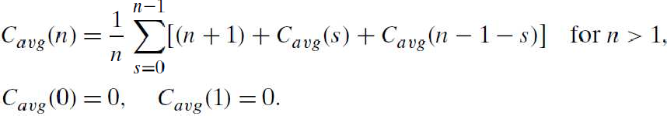

Analysis
Average Case
Assuming that the partition split can happen in each position s with the same probability 1/n, we get

